Slide 1

“Guardian Health ”
Team Members Details
1. U Chandu - 21N31A6756
2. G Akash - 21N31A6721
3. G Yaswanth Sai - 21N31A6718
III Year B.Tech-I Semester – CSE (Data Science)
Under the Guidance of
M.Swathi
Assistant Professor & Dept. of ET
MRCET CAMPUS (UGC AUTONOMOUS INSTITUTION)
B.Tech III Year – I Sem | Application Development – I | External Project Review

Slide 2
Introduction
We're introducing our project, "Disease Prediction with Machine Learning."
In healthcare, quick and precise decisions matter greatly.
Healthcare professionals often diagnose based on symptoms, which can be time-consuming and sometimes prone to errors.
Our project leverages machine learning to speed up and improve the diagnostic process.
It's all about providing faster and more accurate healthcare decisions.
Early disease detection and understanding are essential for successful treatment.
Our project simplifies healthcare choices for healthcare providers and individuals.
Machine learning is increasingly shaping the healthcare field by uncovering hidden patterns and correlations.
We're excited to dive into the project details and show you how we're making healthcare decisions more efficient and accessible.

Slide 3
Abstract
This project focuses on using machine learning to predict diseases based on user-provided symptoms.It involves collecting and preparing a dataset of symptoms and associated diseases.A machine learning model is trained on this dataset to make accurate predictions.Users can input their symptoms through a user-friendly interface to receive disease predictions.The system is designed to handle challenges like data quality, interpretability, ethics, and data security.Continuous feedback from users helps enhance the model's accuracy and reliability.The goal is to provide a valuable healthcare tool for users to make informed decisions.

Slide 4
Proposed System
Purpose: To offer an efficient, accurate, and user-friendly disease prediction solution.
Enhanced system architecture for improved data processing and prediction accuracy.
User-friendly interface designed for simplified symptom input and result presentation.
Improved data management for quicker access to relevant information.
Utilization of the latest technologies and frameworks for enhanced system performance.
Incorporation of feedback mechanisms for continuous system accuracy and user experience improvement.
Conclusion: The proposed system promises a superior disease symptom prediction solution, offering enhanced features, user-friendliness, and overall effectiveness in healthcare decision-making.

Slide 5
Architecture Diagram or
System Diagram

Slide 6
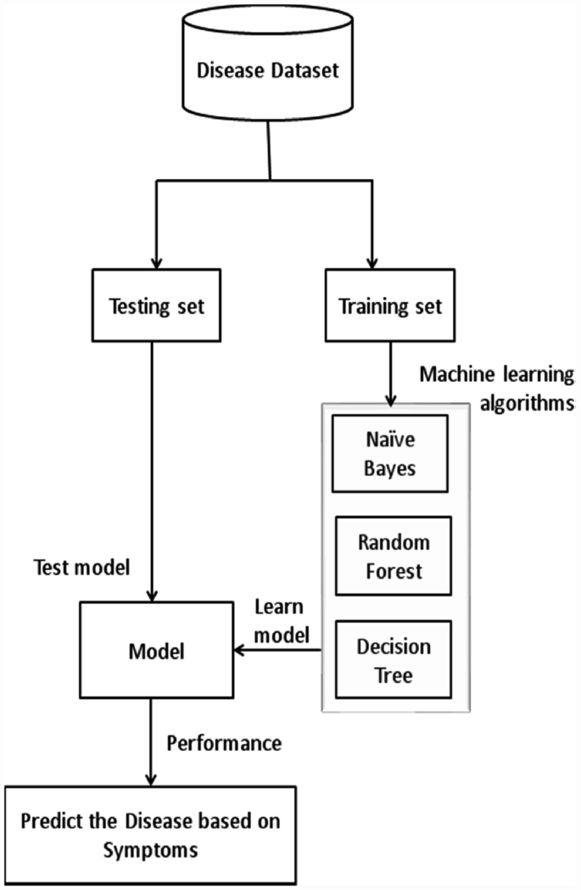
System Architecture

Slide 7
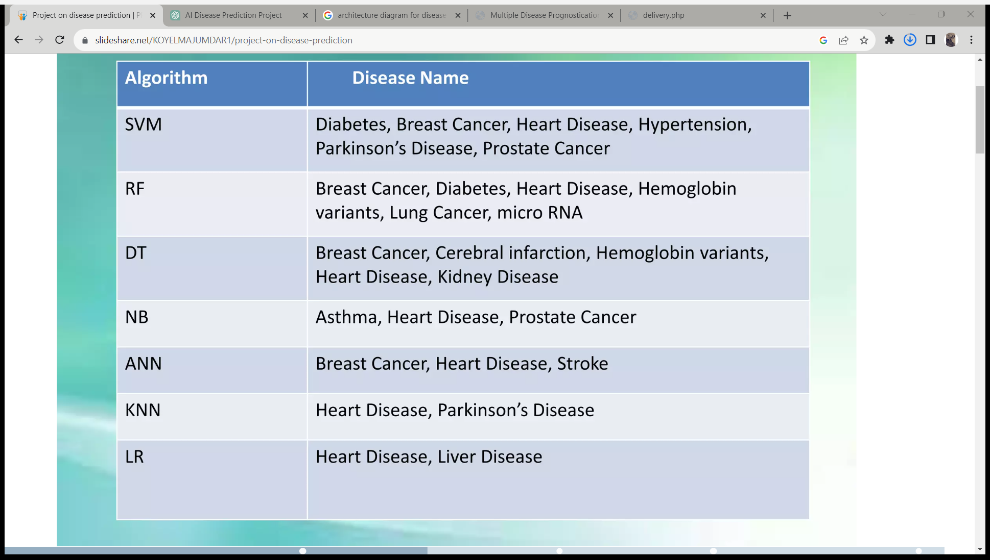
Algorithms
Machine learning algorithms that are used in “Disease Symptom Prediction”

Slide 8
Software Requirements Specification (SRS)

Slide 9
Software Requirement Specifications (SRS)
Programming Languages: Python for machine learning and data processing.
Web development technologies (HTML, CSS, JavaScript) for the user interface.
Web Server: Web server software for hosting the application
Web Development Framework: Web framework (e.g.React js) for the user interface and backend.
Front-end technologies (HTML, CSS, JavaScript) for creating a user
friendly interface.
Machine Learning Libraries: Machine learning libraries (e.g., Scikit-Learn, TensorFlow) for model development.
Database Management System: Database system (e.g., MySQL, PostgreSQL) for data storage and management.

Slide 10
Hardware Requirement Specifications (HRS)
An laptop having:
Internet Connection
2.Windows 7 or higher
3.4gb ram or higher
4.Machine Learning Hardware (Optional)
5.Web Server (if self-hosted)

Slide 11
Application Modules
1)User Interface Module:
  Symptom Input Form: Allows users to input their symptoms. This could include a user-friendly form where users select or describe their symptoms.
2)Data Input Module:
  Data Validation: Validates and sanitizes user inputs to ensure they are accurate and within the expected range.
  Data Preprocessing: Preprocesses user input data before feeding it to the machine learning model.
3)Machine Learning Module:
  Prediction Model: Implements the trained machine learning model for symptom prediction.
  Feature Extraction: Extracts relevant features from user input for model input.
4)Database Module:
  User Profile Management: Stores and manages user profiles and historical data, if needed.
  Data Logging: Logs user interactions and model predictions for analysis and improvement.

Slide 12
Implementation
Data Handling and Processing: Data collection and preprocessing for symptom and disease data.
Machine Learning Model Development:Development of accurate machine learning models for disease prediction.
User Interface Design:User-friendly user interface design for symptom input and results.
User Security:Secure user registration and authentication for data privacy
Deployment and Hosting:Deployment on a reliable web server or cloud platform.
Maintenance and Support:Ongoing maintenance, updates, and responsive user support.
Monitoring and Optimization:Monitoring system performance and optimizing machine learning models.
Feedback Loop:A feedback loop for continuous improvement based on user feedback.

Slide 13
System Models
(UML Diagrams)

Slide 14
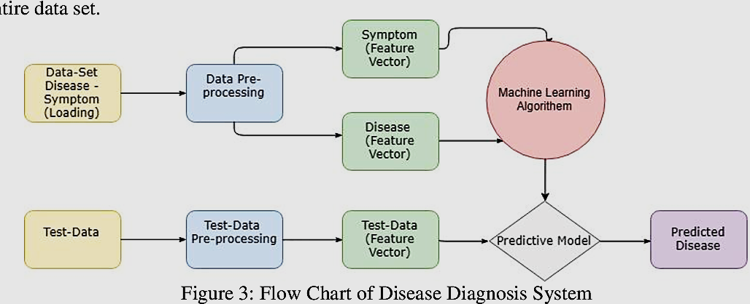
Dataflow Diagram

Slide 15
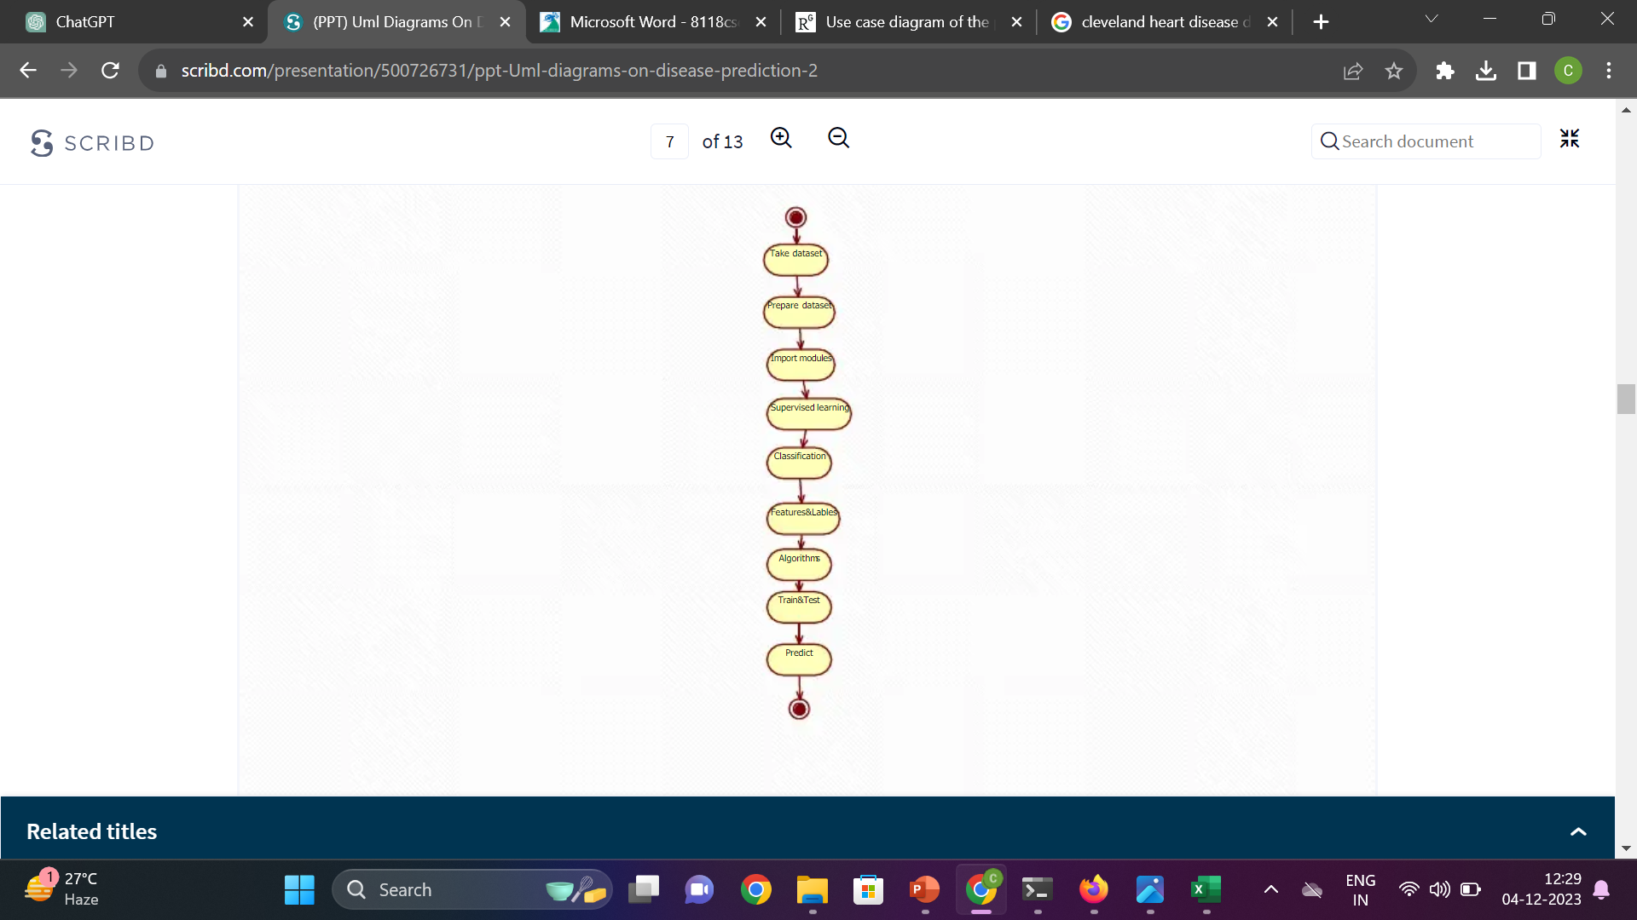
Sequential Diagram

Slide 16
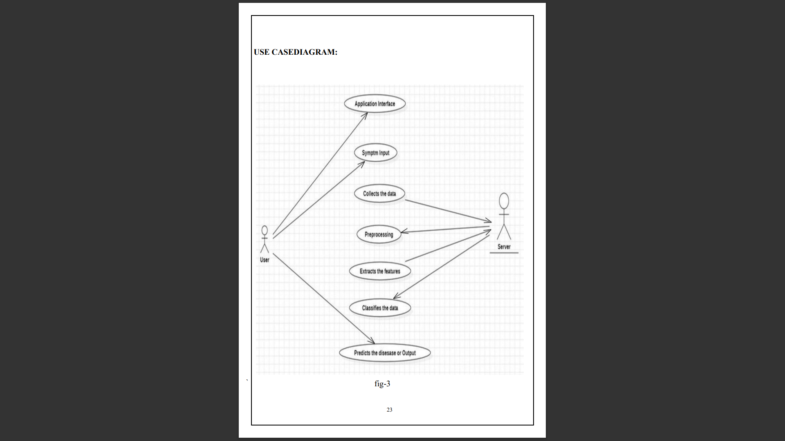
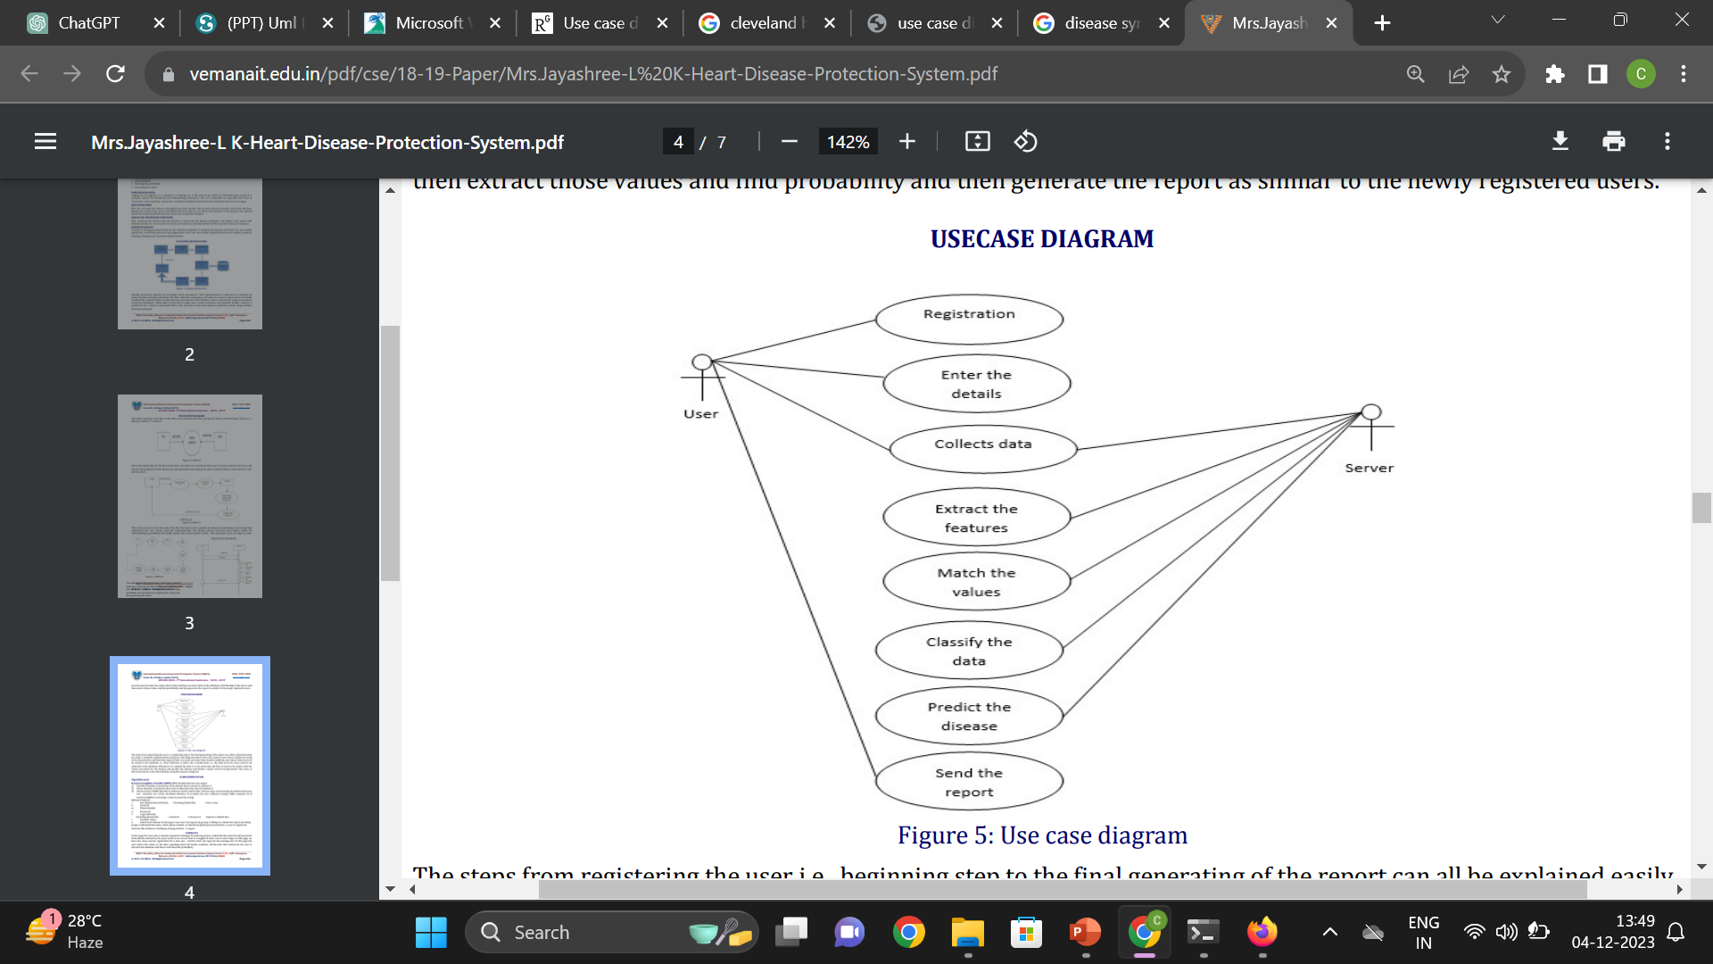
Use-Case Diagram

Slide 17
Output Screens

Slide 18
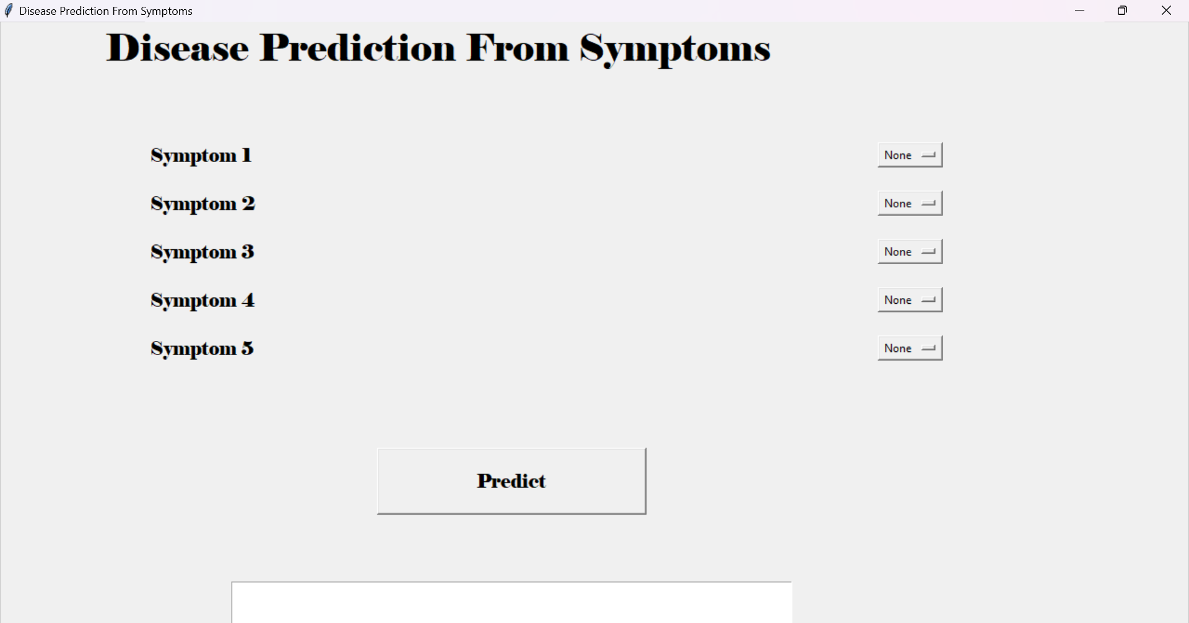
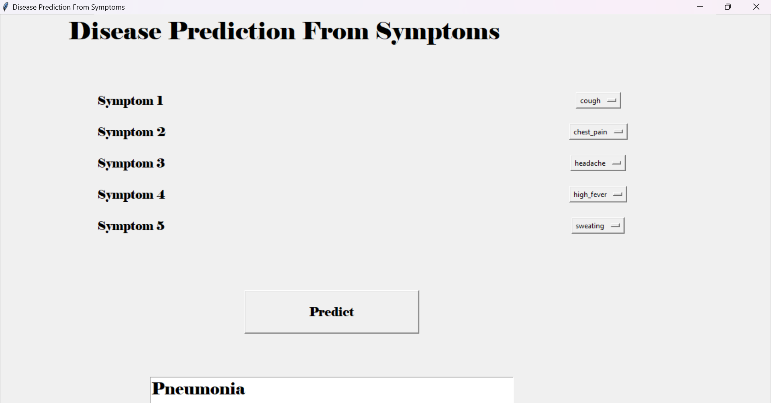
Results (Output Screens)

Slide 19
Conclusion &
Future Scope

Slide 20
Conclusion
In conclusion, our disease symptom prediction project aimed to harness the power of machine learning to improve healthcare decision-making..
Our project motive is to contribute for improving public health by providing accurate disease predictions.
We'll keep focusing on making the system as user-friendly and accessible as possible.
If you have any questions or suggestions, we're here to listen.
I

Slide 21
Future Scope
1) Interoperability and Data Sharing: - Establishing secure frameworks for collaborative healthcare data sharing in regarding privacy concerns.
2) Explainability and Interpretability: - Enhance model interpretability for trust among healthcare professionals.
3) Global Health Initiatives: - Contribute to global health by identifying patterns and trends. Aid in early detection of emerging diseases for proactive public health measures.
4) Continuous Model Improvement: - Adapt models based on new data and technological advancements. Ensuring continuous improvement for staying relevant in dynamic healthcare scenarios.
5) Ethical Considerations: - Address bias, data privacy, and responsible use of predictive models.Ensuring fairness and equity in deploying machine learning in healthcare.

Slide 22
Thank you
Team members details:
G.Akash – 21N31A6721
G.Yaswanth Sai – 21N31A6718
U.Chandu – 21N31A6756

